Slide 1
ADHID
Achievement through Education and Collaboration
By Rev. Pastor Dan White
BS, MATS, Post-Grad and ThD Studies

Slide 2
ADHID
Attention
Deficit
Hyperactivity
Impulsivity
Disorder
Diagnostically known as ADHD, however it should include “I”mpulsivity as this is a strong characteristic of those with ADHD/ADD. (my addition)

Slide 3
What Causes ADHID?
No one is certain
ADHID is a neurological disorder. It is in the brain. It is therefore a brain disorder and ought to be seen and treated like any other disorder.
It can be genetic. Most researchers believe it is genetic, though it could also be caused by environment, parenting, an illness, lead, or maternal issue caused by smoking or alcohol.

Slide 4
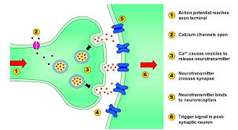
ADHID is a Neurological Disorder

Slide 5
Can ADHID Be Cured?
No
However it is treatable and managed, but it must first be correctly and promptly diagnosed.

Slide 6
How is ADHID Treated?
Proper medication combined with counseling and ADHD coaching.
For students, IEP’s must be implemented and educational professionals must be knowledgeable, understanding and cooperative with this disorder.
Parents, teachers and guidance counselors should all work together for the child’s benefit.

Slide 7
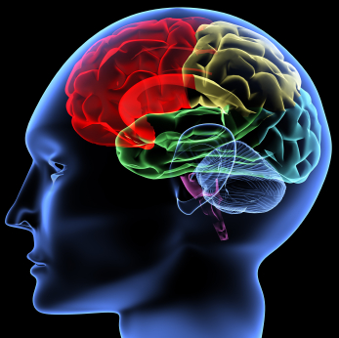
ADHID is in the Brain
Not the Mind or Attitude
Though it can and will affect it

Slide 8
DSM-5
Diagnostic Statistical Manual
of Mental Health Disorders
5th Edition
I would say this is the book for Mental Health Professionals
“The definition of attention-deficit/hyperactivity disorder (ADHD) has been updated in the fifth edition of the Diagnostic and Statistical Manual of Mental Disorders (DSM-5) to more accurately characterize the experience of affected adults.”---DSM-5/American Psychiatric Association
Previously it was thought that ADHD was only a childhood disorder, but over the years mental health professionals have learned that ADHD persists into adulthood and is a chronic disorder. So, DSM-5 has added adult ADHD as a mental health disorder.

Slide 9

Comorbidities
“The simultaneous presence of two chronic diseases or conditions in a patient.”
To reduce the possibility of comorbidities, proper diagnosis and treatment are essential, particularly early on.

Slide 10
Who has ADHID?
Statistics
General Population
4-10% (maybe more, many undiagnosed) have ADHD
Boys Vs. Girls---boys were generally believed to have a higher incidence of ADHD, but the field is evening out as we learn of other symptoms beyond the stereotypical hyperactivity which is mainly seen in boys with ADHD.

Slide 11
Statistics
This Statistic is Stunning!
The U.S. Prison Population
20+ to as high as 75+% of the prison population has ADHD. I have seen statistics ranging from 22-48% and one mental health/ADHD professional has told me it is as high as 75+%. I would say the mean is 33-45%!
What about screening and treating
these people?

Slide 12
Untreated ADHID
The Results of untreated ADHID can be catastrophic.
Oppositional Defiance Behavior (catch this quickly)
Comorbidities to include learning disabilities, depression, psychosis, bi-polar, addiction or abuse, suicide.

Slide 13
What to Watch Out For
Sudden change in your child’s behavior at school and change in grades and cooperation with parents and teachers.
Not wanting to socialize (relationship problems)
No or very few friends
Somewhat uncoordinated with sports activities having spatial difficulties
Day dreaming or spacing out beyond ordinary

Slide 14
What to Watch Out For
Incomplete or lost assignments, frustration
Sleeplessness, insomnia
Fidgety, unable to sit still
Talks too much or cuts people off when they are talking.
Do very well at what they are interested in, hyper-Focusing in comparison to boredom with what does not interest.

Slide 15
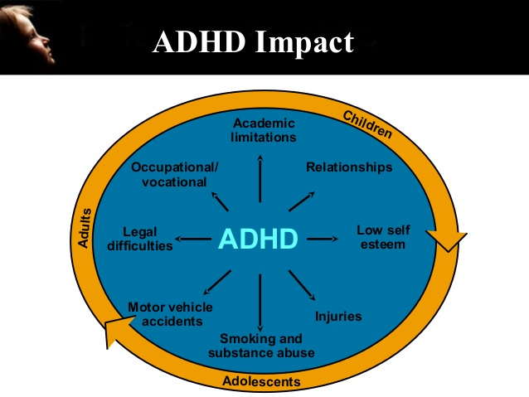
Be Aware!
adolescents

Slide 16
The Outcome
The sky is the limit (I know several with this disorder, and are quite successful
and adjusted. You wouldn’t know they have it)
Many excel greatly with what interests them.
The key is early diagnosis and combined treatment with understanding people
It does not go away, rather one may be able to compensate in other areas to diminish it, but it will not go away. It is chronic, long-term.

Slide 17
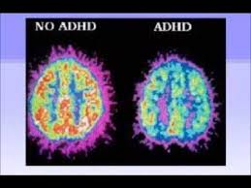
ADHID People are very normal
Their brains are just wired and fire
somewhat differently.

Slide 18
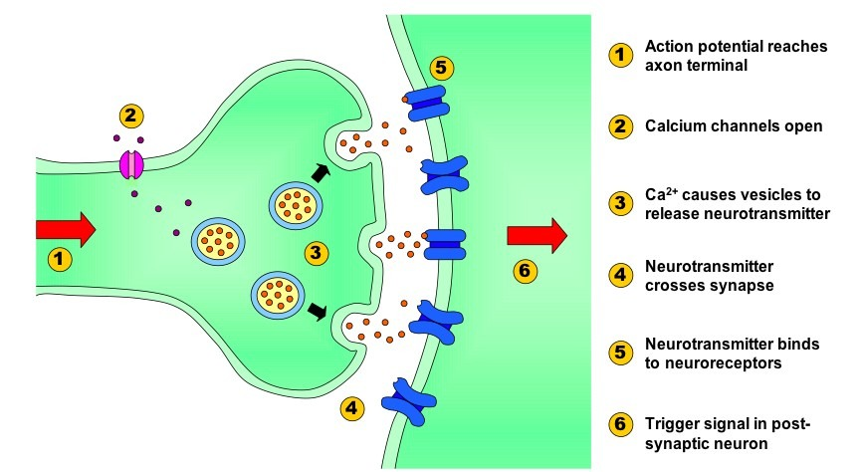
Neurologically Speaking
There is a synaptic problem in the neurotransmitters of the brain.
This is how it is suppose to work:

Slide 19
Neurologically Speaking
This is how an ADHID brain works.
Certain areas of the brain mature much slower, lagging up to three years. The brain also communicates within itself through neurotransmitters. The most affected part of the brain is the pre-frontal cortex, responsible for memory, emotion, inhibition, planning and reason. In the ADHD brain the neurotransmitters responsible for this are disrupted.

Slide 20
What Should Be Done?
Learn (Knowledge)
Understand (Wisdom)
Awareness and Advocacy
Research
Treat, Treat, Treat----Lifelong

Slide 21
Conclusion
I believe that following those steps will result in greater student achievement, less depression and comorbidities, less substance abusers and addicts, hence less crime and less numbers in prison, and less totally senseless deaths through suicide, because the truth of ADHID will be known and sufferers will find relief, hope and success for a brighter future.

